Slide 1
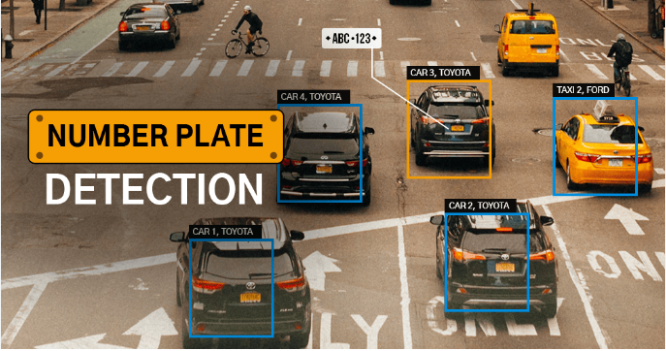

Vehicle Plate Detection
RUBAB TAHIR (FA22-BSE-108 )
MUHAMMAD AFZAAL (FA22-BSE-040)
MUNIBA QASIM (FA22-BSE-168 )
12/12/2024

Slide 2

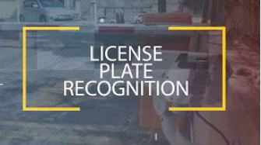
Introduction
What is Vehicle License Plate Detection?
A technology to identify and read license plate numbers from images.
Applications include traffic monitoring, toll systems, and parking management.
Objective of the Project
Develop a MATLAB-based application to detect and display vehicle license plate numbers from uploaded images.

Slide 3




Project Overview
Domain: Digital Image Processing
Tool & Language: MATLAB, App Designer
Key Features:
Upload vehicle images.
Preprocess the image for plate detection
Extract and display the license plate number.
Cross-check plate numbers with a database file

Slide 4
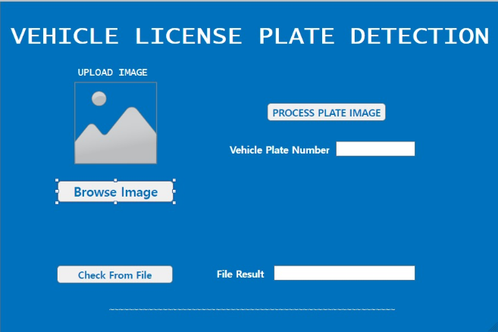

App Features: User-friendly GUI built with MATLAB App Designer. Components include : 1) Image upload button. 2) Plate processing button. 3) Text fields for detected plate number and file verification results. 4) Supports image formats: .png, .jpg, .jpeg.
Interface Design
4

Slide 5
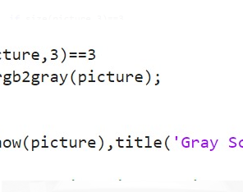
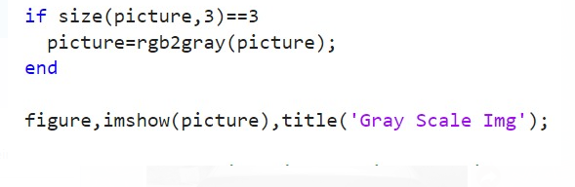
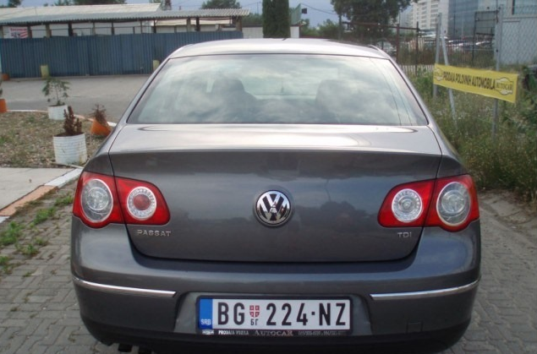
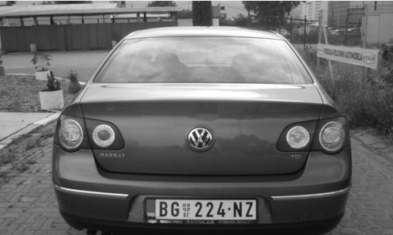
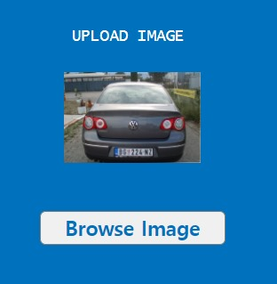
Technical Workflow
1) Image Upload:
User selects a vehicle image.

Slide 6
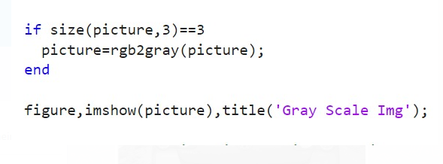
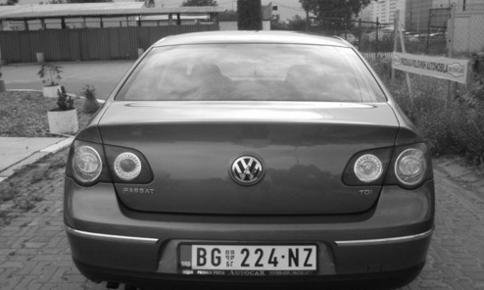
Technical Workflow
2) Preprocessing
2.1) Convert to grayscale:
It transforms the image into shades of gray.

Slide 7
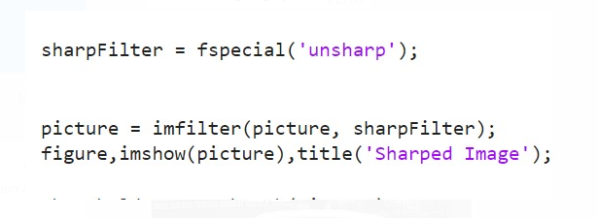
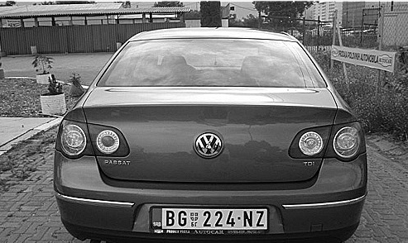
Technical Workflow
2) Preprocessing
2.2) Apply sharpening filter: It enhances edges and details for better plate recognition.

Slide 8
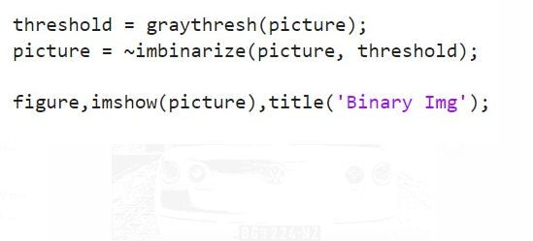
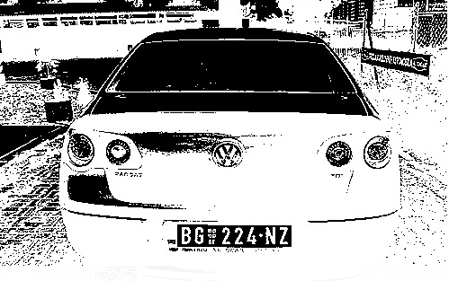
Technical Workflow
2) Preprocessing
2.3) Convert to binary image: It Converts the image to black-and-white for easier segmentation.

Slide 9
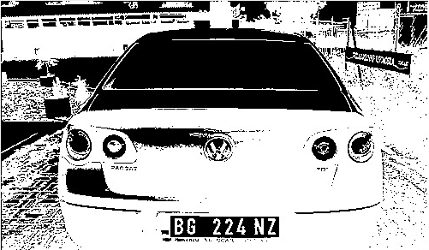
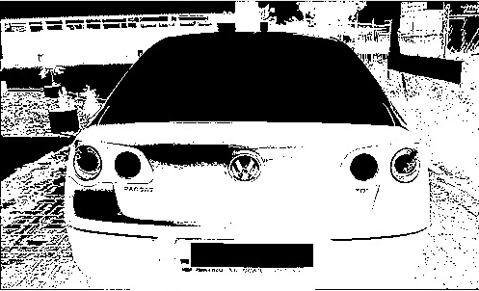
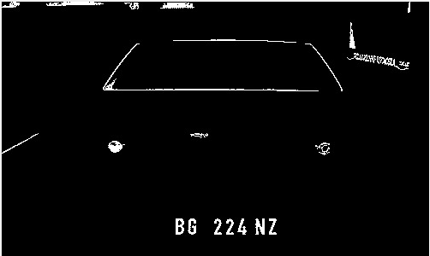

Technical Workflow
3) Plate Detection
3.1) Isolate license plate region :
It Identify and extract the specific area containing the license plate from the image.

Slide 10
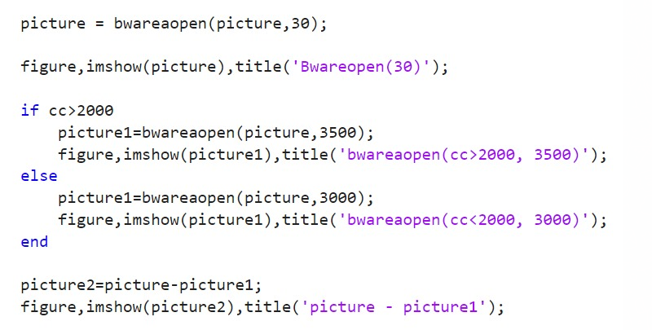
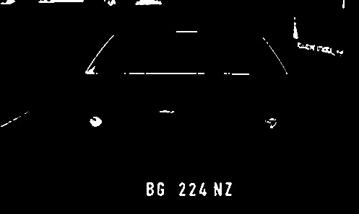
Technical Workflow
3) Plate Detection
3.2) Enhance Plate Region:
It Improves the clarity of the extracted plate region for better character segmentation.

Slide 11
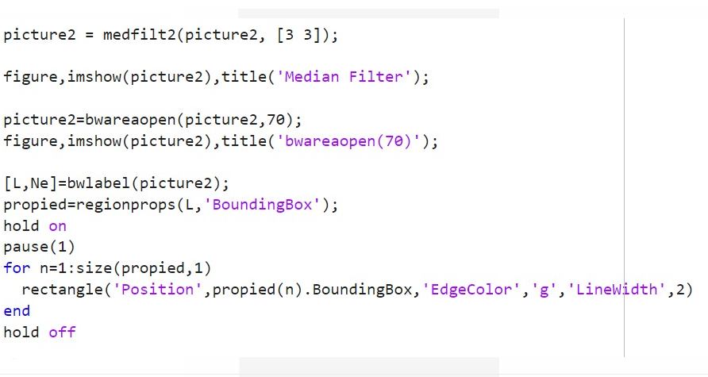
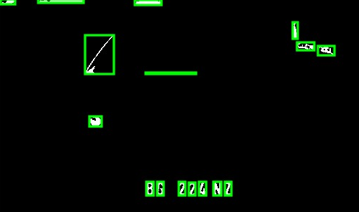
Technical Workflow
3) Plate Detection
3.3) Extract Characters:
It segments the characters within the license plate for recognition.

Slide 12
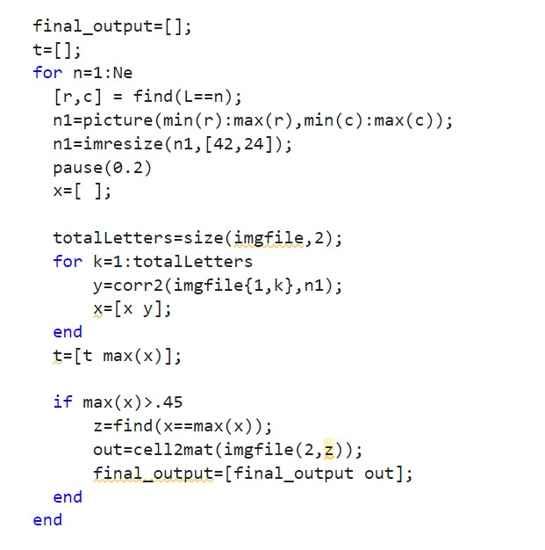
Technical Workflow
4) Number Recognition:
Display detected plate number.
Compare characters with stored data.

Slide 13
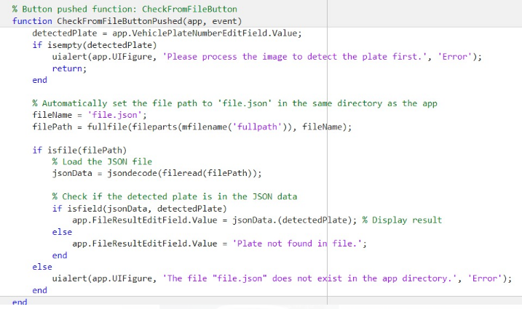
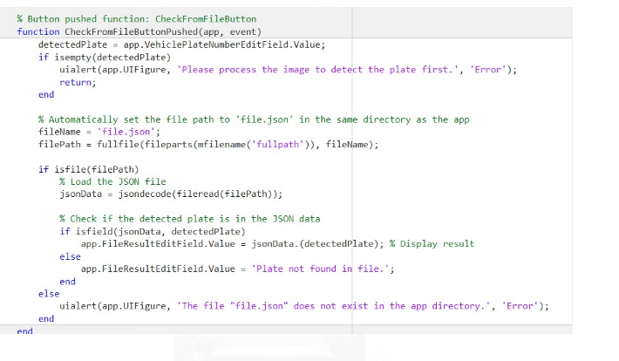

5) Verification: It Checks detected plate against file.json.
Technical Workflow

Slide 14
MATLAB Code Highlights
1)App Interface:
Written in MATLAB’s App Designer.
PROCESSPLATEIMAGEButton to process uploaded images.
2)Image Processing:
imresize for resizing.
rgb2gray for grayscale conversion.
imbinarize for binary thresholding.
Filtering and segmentation.
3)Database Matching:
JSON file lookup for verification

Slide 15
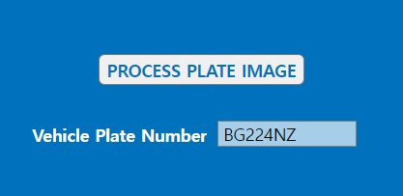

Results
Uploaded vehicle image.
Preprocessed and detected plate region.
Extracted plate number displayed on GUI.
Accurate detection for clear images.
Limitations for poor lighting or low-quality images.

Slide 16

Challenges
1) Technical Challenges:
Handling images with poor resolution.
Differentiating between plate numbers and other text.
2) Implementation Challenges:
Ensuring robust character segmentation.
Creating an intuitive and error-free GUI.

Slide 17
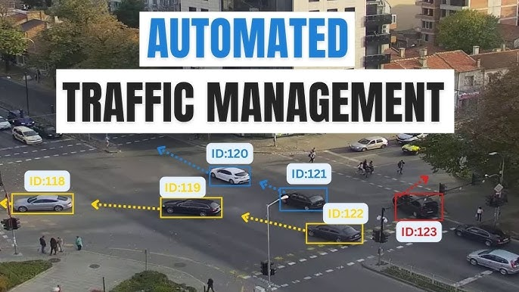
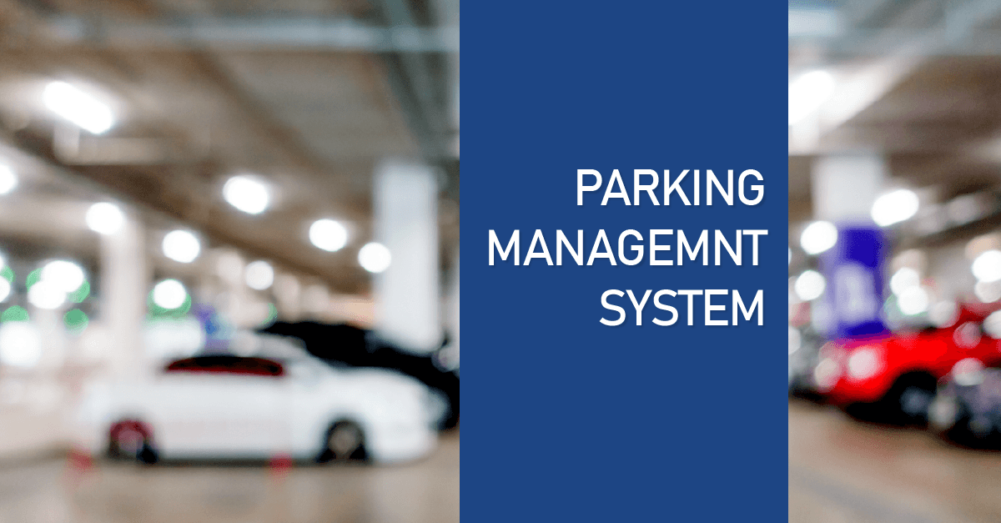
Applications
Real-World Use Cases:
Automated traffic enforcement.
Parking management systems.
Toll collection systems.
Security surveillance

Slide 18

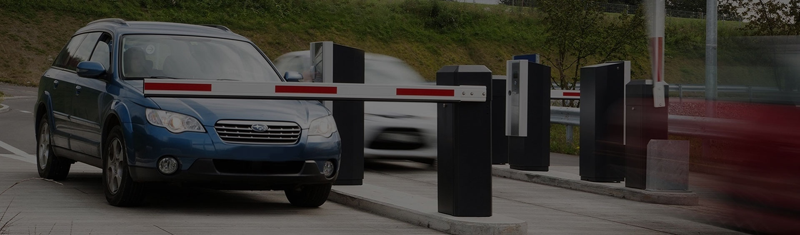



Conclusion
Achievements:
1) Successfully implemented vehicle plate detection.
2) Interactive GUI with seamless image processing.
.
Future Work:
1) Improve accuracy for challenging conditions.
2) Integrate with real-time video feeds.
3) Implement YOLO model for real time detection.
Q&A:
Open for any questions or feedback.
12/12/2024

